Slide 1

Red team Findings PRESENTATION
By : Xolisile Dladla

Slide 2

Agenda
Introduction
Security Misconfigurations(flag 1)
Broken Access control vulnerability (flag 1)
Identification & Authentication Failure (fla2)
Flag 3
Flag 4
Tools and techniques used
Conclusion and challenges faced
This Photo by Unknown Author is licensed under CC BY-ND

Slide 3

Introduction
Objective :To identify and exploit vulnerabilities in the system, uncovering hidden flags and providing recommendations for improvement
The number of flags identified (4)
Tool used : Burp suite
This Photo by Unknown Author is licensed under CC BY-NC

Slide 4
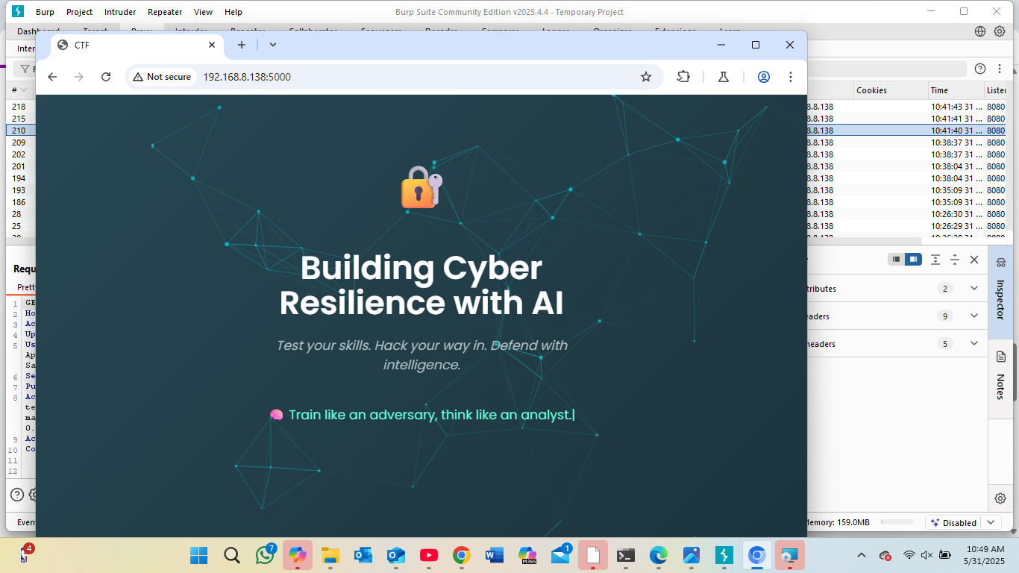

Slide 5
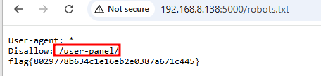
Security misconfiguration
Using the most common web application endpoint (robots txt )it reveal an endpoint called user-panel.
Security risk
robot.txt is meant for search engines and not hide secret pages from public
It is common that attackers often use robots.txt to find admin paths

Slide 6
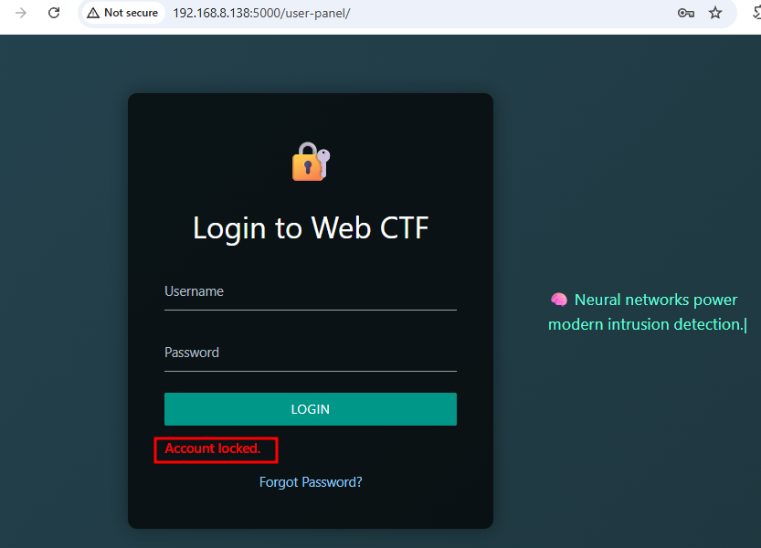
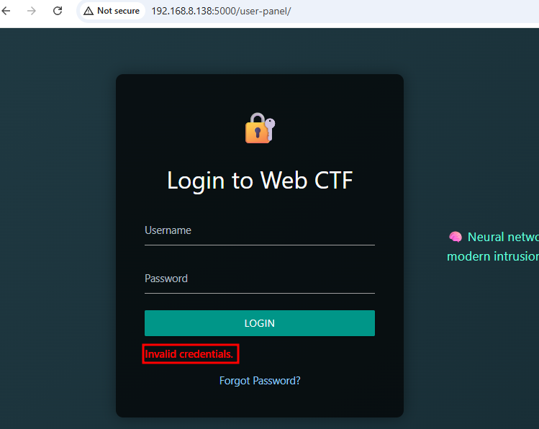

Login Attempts
Admin –admin attempt worked, l used that as my clue
Other common credentials (i.e username-username)

Slide 7
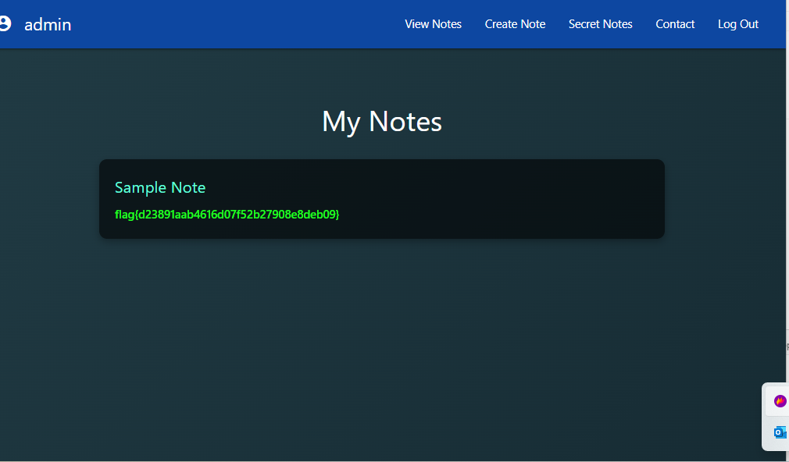
Security misconfiguration
By using the admin’--– and password as anything l bypassed the login page
🔓 Flag 2 unlocked
Vulnerability name : Broken Authentication
OWASP Top 10 (2021): A07 – Identification and Authentication Failures

Slide 8


Note: Security risk
🚨 Why It’s Dangerous?
Attackers can log in as admin
They can steal data, change settings, or upload malware
It bypasses the entire purpose of having passwords
✅ Recommendation
🔐 1. Always Validate Username and Password Together
Make sure both fields are required, and must match correctly
Implementing multi-factor authentication
Use secure password hashing (e.g. bcrypt) to check passwords
Never allow login if only a username is valid

Slide 9
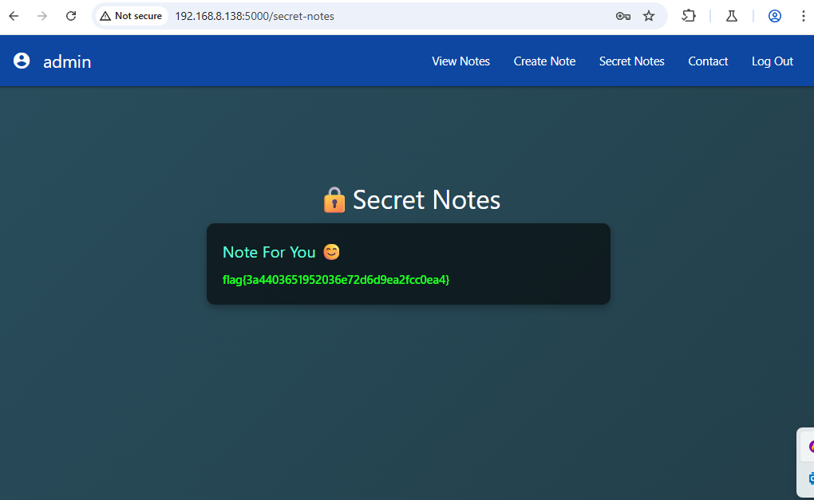
PIN was required Under the ‘secret note’ tab

Slide 10
Unlocking the “pin”
By understanding the algorithm used , I managed to reveal the pin
Pin:12345
Third flag unlocked

Slide 11


🏁 Vulnerability name :
🔐 Software and Data Integrity Failures (OWASP Top 10 - A08:2021)
Security Risk: Using weak hashing (MD5) for PINs allows attackers to reverse the hash and gain unauthorized access to sensitive areas.
Recommended Solution:
Replace MD5 with a secure algorithm like bcrypt or argon2, and enforce strong PIN policies with rate limiting.

Slide 12
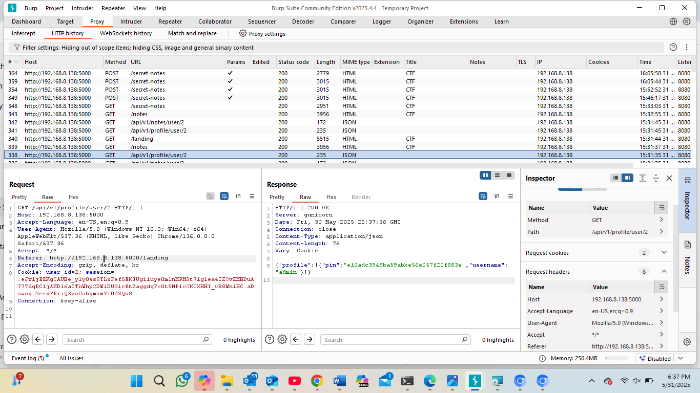

Slide 13
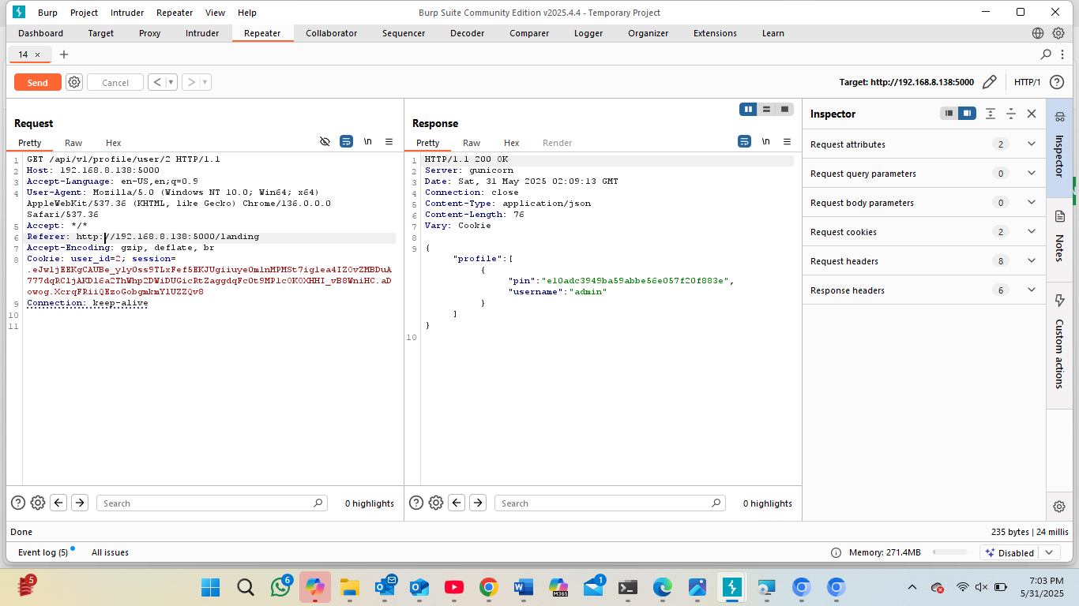


Slide 14
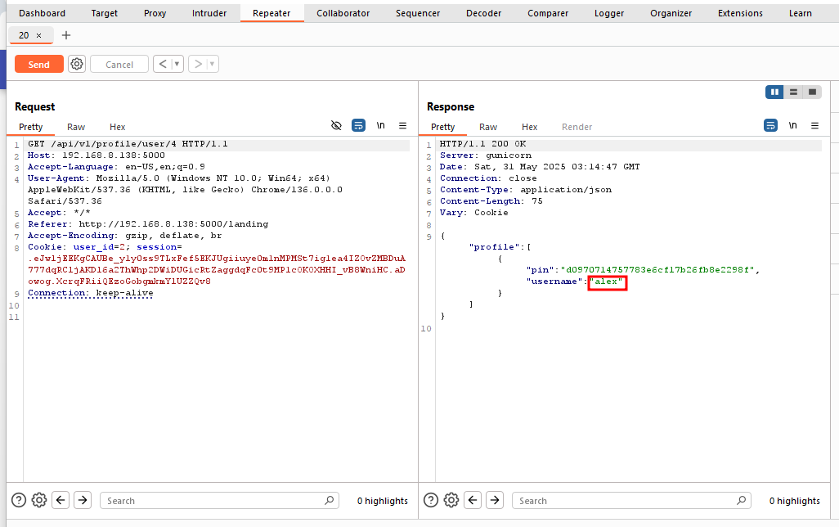

Slide 15
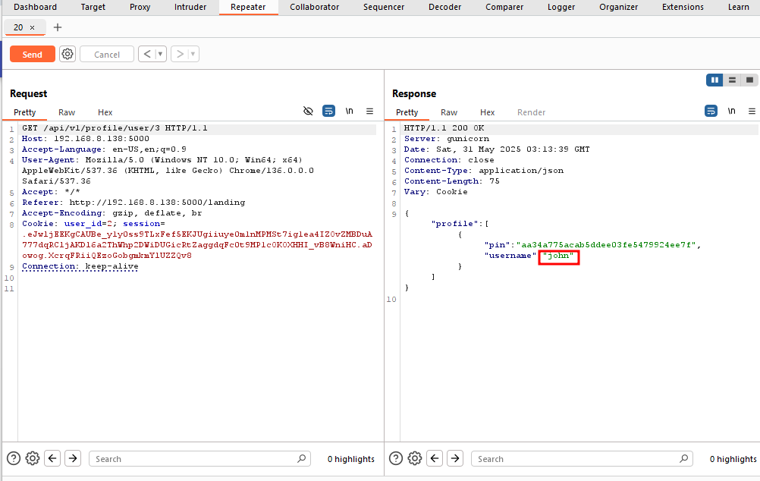


Slide 16
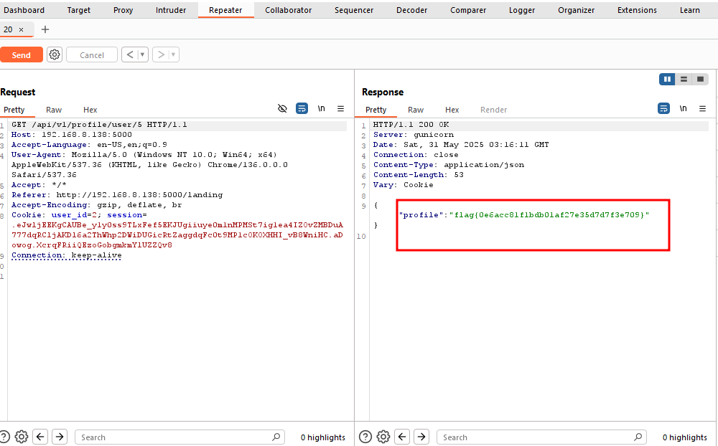

Vulnerability name:
Insecure Direct Object Reference
Solution
Validate access right and use indirect references instead.

Slide 17

Discoveries
Number of users and their names
The hashed pin discovered
Next steps ?
Try to cracked the hashed pin
Individually login in each users profile to uncover another flag.

Slide 18
Resources & Techniques used
Techniques used:
SQL Injection
Burp Suite for manual interception
Discovery via robots.txt
Authentication bypass
Hash cracking /bruce-forcing .

Slide 19

Challenges faced & Outcomes
Overcoming troubleshoot and obstacles
Time management and prioritization
Limited experience with the hacking tool
Learning new tools and libraries
Outcomes
Gained few skills such as penetrating testing ,critical thinking ,problem solving and communication
This Photo by Unknown Author is licensed under CC BY-NC-ND

Slide 20

THANK YOU
Xolisile Dladla Team
May 2025
202212974@spu.ac.za
#ITSUMMIT2025

